Slide 1

24CSA212 –
Full Stack Frameworks
Introduction to react js

Slide 2
Introduction to React JS
React is a front-end JavaScript library.
React was developed by the Facebook Software Engineer Jordan Walke.
React is also known as React.js or ReactJS.
React is a tool for building UI components.

Slide 3
How does React Work?
React creates a VIRTUAL DOM in memory.
Instead of manipulating the browser's DOM directly, React creates a virtual DOM in memory, where it does all the necessary manipulating, before making the changes in the browser DOM.
React only changes what needs to be changed!
React finds out what changes have been made, and changes only what needs to be changed.

Slide 4
History & Evolution of React
SECTION 01 — INTRODUCTION
2011
2013
2015
React created internally at Facebook by Jordan Walke
React open-sourced at JSConf US — community skeptical
React Native released; React v0.13 introduces ES6 classes
2016
2017
2018
React v15 — improved DOM rendering performance
React v16 (Fiber) — complete architecture rewrite
React Hooks introduced in v16.8 — game changer!
2020
2022
2024
React v17 — no new features, improved upgrade path
React v18 — Concurrent Mode, Suspense, useTransition
React 19 — Server Components, Actions, new hooks

Slide 5
Key Features
Component-Based Architecture
  UI is broken into small, reusable pieces called components.
  Each component manages its own state and logic.
Virtual DOM
  React uses a virtual representation of the DOM to efficiently update only the parts of the UI that change, improving performance.
Declarative UI
  You describe what the UI should look like, and React updates it automatically when data changes.
Unidirectional Data Flow
  Data flows in one direction (parent → child), making the app predictable and easier to debug.
JSX (JavaScript XML)
  A syntax extension that allows writing HTML-like code inside JavaScript.

Slide 6
Key Features
The diffing algorithm is React’s smart way of figuring out what changed in the UI and updating only that part in the real DOM.
1. Virtual DOM
React uses a Virtual DOM to optimize UI rendering. Instead of updating the entire real DOM directly, React:
Creates a lightweight copy of the DOM (Virtual DOM).
Compares it with the previous version to detect changes (diffing).
Updates only the changed parts in the actual DOM (reconciliation), improving performance.
2. Component-Based Architecture
React follows a component-based approach, where the UI is broken down into reusable components. These components:
Can be functional or class-based.
It allows code reusability, maintainability, and scalability.
without requiring full-page reloads.

Slide 7
Key Features
3. JSX (JavaScript XML)
React uses JSX, a syntax extension that allows developers to write HTML inside JavaScript. JSX makes the code:
More readable and expressive.
Easier to understand and debug.
4. One-Way Data Binding
React uses one-way data binding, meaning data flows in a single direction from parent components to child components via props.
This provides better control over data and helps maintain predictable behavior.
5. State Management
React manages component state efficiently using the useState hook (for functional components) or this.state (for class components).
State allows dynamic updates without reloading the page.

Slide 8
Key Features
6. React Hooks
Hooks allow functional components to use state and lifecycle features without needing class components. Common hooks include:
useState: for managing local state.
useEffect: for handling side effects like API calls.
useContext: for global state management.
7. React Router
React provides React Router for managing navigation in single-page applications (SPAs).
It enables dynamic routing

Slide 9
Key Features
Advantages
High performance due to Virtual DOM.
Reusable components reduce development time.
Large community and ecosystem.
Easy integration with other libraries or frameworks.

Slide 10
Key Features
How it works:
Welcome is a functional component that takes props and returns JSX.
ReactDOM.createRoot renders the component into the HTML element with id="root".
Basic Example
import React from "react";
import ReactDOM from "react-dom/client";
// Functional Component
function Welcome(props) {
return <h1>Hello, {props.name}!</h1>;
}
// Rendering the component
const root = ReactDOM.createRoot(document.getElementById("root"));
root.render(<Welcome name="React Developer" />);

Slide 11
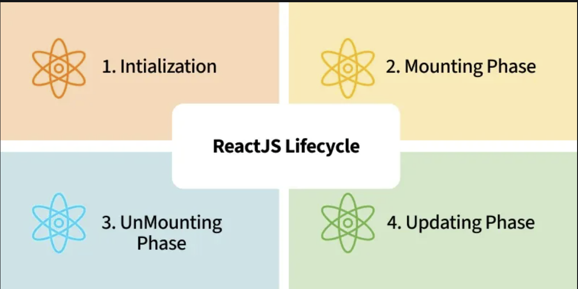
ReactJS Lifecycle
Every React Component has a lifecycle of its own, the lifecycle of a component can be defined as the series of methods that are invoked in different stages of the component’s existence.
React automatically calls these methods at different points in a component’s life cycle.
Understanding these phases helps manage the state, perform side effects, and optimize components effectively.

Slide 12
ReactJS Lifecycle
1. Initialization
This is the stage where the component is constructed with the given Props and default state.
This is done in the constructor of a Component Class.
2. Mounting Phase
Constructor: The constructor method initializes the component. It’s where you set up the initial state and bind event handlers.
render(): This method returns the JSX representation of the component. It’s called during initial rendering and subsequent updates.
componentDidMount(): After the component is inserted into the DOM, this method is invoked. Use it for side effects like data fetching or setting timers.

Slide 13
ReactJS Lifecycle
3. Updating Phase
componentDidUpdate(prevProps, prevState): Called after the component updates due to new props or state changes. Handle side effects here.
shouldComponentUpdate(nextProps, nextState): Determines if the component should re-render. Optimize performance by customizing this method.
render(): Again, the render() method reflects changes in state or props during updates.
4. Unmounting Phase
componentWillUnmount(): Invoked just before the component is removed from the DOM.
Clean up resources (e.g., event listeners, timers).

Slide 14
Applications of React
Web Development: React is used to build dynamic and responsive web applications, including social media platforms, e-commerce sites, and blogs.
Mobile Apps: React Native allows developers to build mobile apps for iOS and Android using the same codebase.
Enterprise Applications: React is used in building large-scale enterprise applications that require a highly interactive UI.
Dashboards and Data Visualizations: React is great for building real-time dashboards and data visualization tools due to its high performance.

Slide 15
JSX Syntax Basics
Example:
import React from "react";
import ReactDOM from "react-dom/client";
function App() {
const name = "Alice";
const items = ["Apple", "Banana", "Cherry"];
return (
<div>
<h1>Hello, {name}!</h1>
<ul>
{items.map((item, index) => (
<li key={index}>{item}</li> {/* Dynamic list rendering */}
))}
</ul>
</div>
);
}
const root = ReactDOM.createRoot(document.getElementById("root"));
root.render(<App />);
JSX (JavaScript XML) lets you write HTML-like code inside JavaScript.
It is not HTML — it’s syntactic sugar for React.createElement().
Rules:
Must have one parent element.
Use camelCase for attributes (className instead of class, onClick instead of onclick).
JavaScript expressions go inside {}.
Self-close tags without children (<img />).
Use {} for dynamic values.

Slide 16
React Components
React apps are built from components — reusable UI pieces.
Types of Components
Functional Components (modern, preferred)
Class Components (older, still supported)
Class Component Example
import React, { Component } from "react";
class Greeting extends Component {
render() {
return <h2>Hello, {this.props.name}!</h2>;
}
}
class App extends Component {
render() {
return (
<div>
<Greeting name="Alice" />
<Greeting name="Bob" />
</div>
);
}
}
Functional Component Example
function Greeting(props) {
return <h2>Hello, {props.name}!</h2>;
}
function App() {
return (
<div>
<Greeting name="Alice" />
<Greeting name="Bob" />
</div>
);
}
Arguments can be passed into a component as props, which stands for properties.

Slide 17
State Management
State management is one of the important and unavoidable features of any dynamic application. React provides a simple and flexible API to support state management in a React component.
What is state?
State represents the value of a dynamic properties of a React component at a given instance.
React provides a dynamic data store for each component.
The internal data represents the state of a React component and can be accessed using this.state member variable of the component.
Whenever the state of the component is changed, the component will re-render itself by calling the render() method along with the new state.

Slide 18
React Hooks
React Hooks are special functions provided by React to handle a specific functionality inside a React functional component.
React provides a Hook function for every supported feature.
For example, React provides useState() function to manage state in a functional component.
When a React functional component uses React Hooks, React Hooks attach itself into the component and provides additional functionality.
The general signature of useState() Hook is as follows −
const [<state variable>, <state update function>] = useState(<initial value>);
For example, state management in clock component using Hooks can be done as specified below −
const [currentDateTime, setCurrentDateTime] = useState(new Date()); setInterval(() => setCurrentDateTime(new Date()), 1000);

Slide 19
React Hooks
React Hooks are special functions provided by React to handle a specific functionality inside a React functional component.
React provides a Hook function for every supported feature.
For example, React provides useState() function to manage state in a functional component.
When a React functional component uses React Hooks, React Hooks attach itself into the component and provides additional functionality.
The general signature of useState() Hook is as follows −
const [<state variable>, <state update function>] = useState(<initial value>);
For example, state management in clock component using Hooks can be done as specified below −
const [currentDateTime, setCurrentDateTime] = useState(new Date()); setInterval(() => setCurrentDateTime(new Date()), 1000);

Slide 20
React Routes for Navigation
React Routes are specifically used for navigation between pages or views in a React application, especially in Single Page Applications (SPAs).
Instead of reloading the entire page, React Router handles navigation client-side, enabling smooth transitions and better performance.
React itself doesn’t have built-in routing, so developers use react-router-DOM to define routes, manage URLs, and render components based on the current path.

Slide 21
React Routes for Navigation- Example
// Install React Router
// npm install react-router-dom
import { BrowserRouter, Routes, Route, Link } from "react-router-dom";
function Home() {
return <h1>Home Page</h1>;
}
function About() {
return <h1>About Page</h1>;
}
function Contact() {
return <h1>Contact Page</h1>;
}
export default function App() {
return (
<BrowserRouter>
{/* Navigation Links */}
<nav>
<Link to="/">Home</Link> |{" "}
<Link to="/about">About</Link> |{" "}
<Link to="/contact">Contact</Link>
</nav>
{/* Route Definitions */}
<Routes>
<Route path="/" element={<Home />} />
<Route path="/about" element={<About />} />
<Route path="/contact" element={<Contact />} />
</Routes>
</BrowserRouter>
);
}
In this example:
BrowserRouter wraps the app to enable routing.
Link changes the URL without reloading the page.
Routes contains multiple Route definitions mapping paths to components.

Slide 22
React-Router Hooks
Routing
Routing is the process of defining and managing navigation in an application so users can move between different views, pages, or sections within the app.
Displays different components based on the URL.
Enables seamless navigation without full page reloads.

Slide 23
React-Router Hooks
Types of Routing Hooks
These are 4 React Router Hooks in v5 that you can use in your React applications:
1. useNavigate Hook
The useNavigate hook replaces the useHistory hook from React Router v5 for programmatic navigation. It provides a navigate function, which let's you navigate to different routes in your application.
2. useParams Hook
The useParams hook is used to access the URL parameters from dynamic routes. It returns an object with key-value pairs representing the parameters.

Slide 24
React-Router Hooks
3. useLocation Hook
The useLocation hook is provided by React Router and is used to access information about the current URL in your app. It is especially useful when you want your component’s behavior or content to change depending on the current route, query parameters, or URL hash.
4. useMatch Hook
The useMatch hook is a part of React Router v6 and is used to match the current URL to a given pattern. It provides a simpler and more flexible way to match routes compared to previous versions.

Slide 25
Companies using React
1. Facebook
Use Case: Core web interface, dynamic news feed, and interactive UI components.
Why React: React was originally developed by Facebook to handle complex UI updates efficiently.
2. Instagram
Use Case: Entire web app, including stories, explore page, and real-time updates.
Why React: Smooth rendering of media-heavy content and real-time interactions.
3. WhatsApp Web
Use Case: Web-based messaging interface.
Why React: Fast updates for chat messages and notifications without full page reloads.
4. Netflix
Use Case: Frontend for TV and web apps.
Why React: Optimized performance for low-bandwidth devices and fast rendering.
5. Airbnb
Use Case: Booking platform with interactive maps, filters, and listings.
Why React: Component reusability and dynamic search/filtering.
6. Uber
Use Case: Web dashboard for drivers, riders, and internal tools.
Why React: Real-time location updates and smooth UI transitions.
7. Discord
Use Case: Web and desktop chat application.
Why React: Handles frequent UI updates for messages, voice channels, and notifications.
8. Shopify
Use Case: E-commerce store builder and admin dashboard.
Why React: Modular UI components for store customization.
9. Pinterest
Use Case: Image-heavy social platform.
Why React: Efficient rendering of infinite scrolling and media grids.
10. Reddit
Use Case: Interactive feed, comments, and voting system.
Why React: Handles large-scale user interactions with minimal lag.

